Slide 1


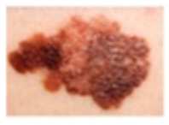
The Use of Artificial Intelligence (AI) to Detect and Predict Skin Cancer Types
Jamel Jara
Week # 10
CS 687and Capstone Project
Sem Spring 2024 MS in Computer Science
School of Technology & Computing (STC)
Notes:
CityU logo cannot be deleted.
Design can be modified for your preference.

Slide 2
Agenda
Introduction
Problem Statement
Motivation
Background
Related Work
Literature Review
Approach
Data Collection
Data Analysis
Finding
Conclusion
Future Work
Key References
Q&A

Slide 3
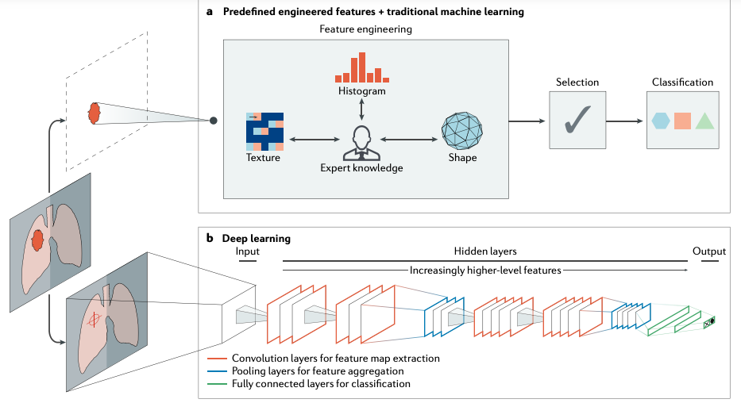
Introduction
The artificial intelligence application is in diagnosis of medical images using advanced AI technologies in clinical practice.
We use artificial intelligent (AI) for detection, assessment, and prediction analysis of imaging with large data in radiology, dermatology, or cardiology for faster and precision service.
AI helps radiologist, cardiologist, or dermatologist for better accuracy, faster diagnoses, reduce costs, and save lives.
Introduction of AI application for analysis of imaging for breast cancer, oncology, neurosurgeon, and so forth making a big difference.

Slide 4
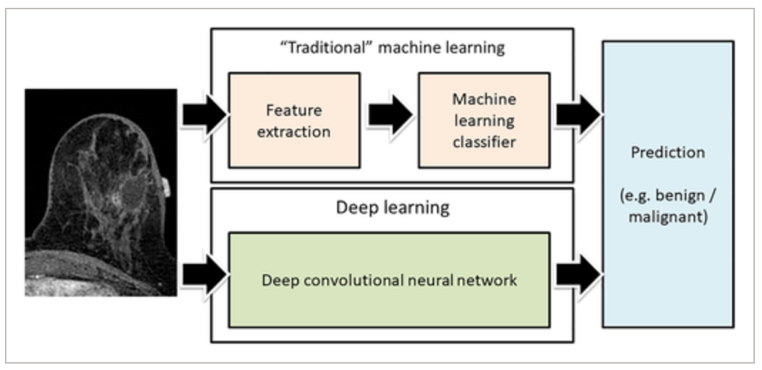
Problem Statement
AI technologies advancement provides quicker diagnosis of diseases, and better patient outcomes. But it is a problem to have small dataset features .
This research proposes to determine how artificial intelligence impact on large dataset early detection of the different skin cancer types of images accurately.

Slide 5
Motivation
The objective of this project is to improve patient care by identifying skin cancer types in the early stages by using convolutional neural networks (CNN), deep learning (DL), and machine learning (ML).
Predict diagnosis using artificial intelligence imaging

Slide 6
Background
The term convolutional neural network (CNN) refers to a type of deep neural network.
Artificial intelligence techniques are used in this research to detect objects and recognize images.
Filters in convolutional neural network are used to extract features from images and detect patterns.
AI techniques such as reduction of costs, high efficiency, and saving time for providers to focus on other cases.

Slide 7
Related Work
Radiology, dermatology, or cardiology are one of the important parts of healthcare components.
Artificial intelligence (AI) technologies are advancing in the detection of diseases and solving problems quickly.
Artificial intelligence provides insights and patterns not visible to radiologists, cardiologists, or dermatologists to analyze complex medical imaging datasets.
AI is playing a role in prediction of diseases, timely treatment response, better cost savings, and better patient outcomes.

Slide 8
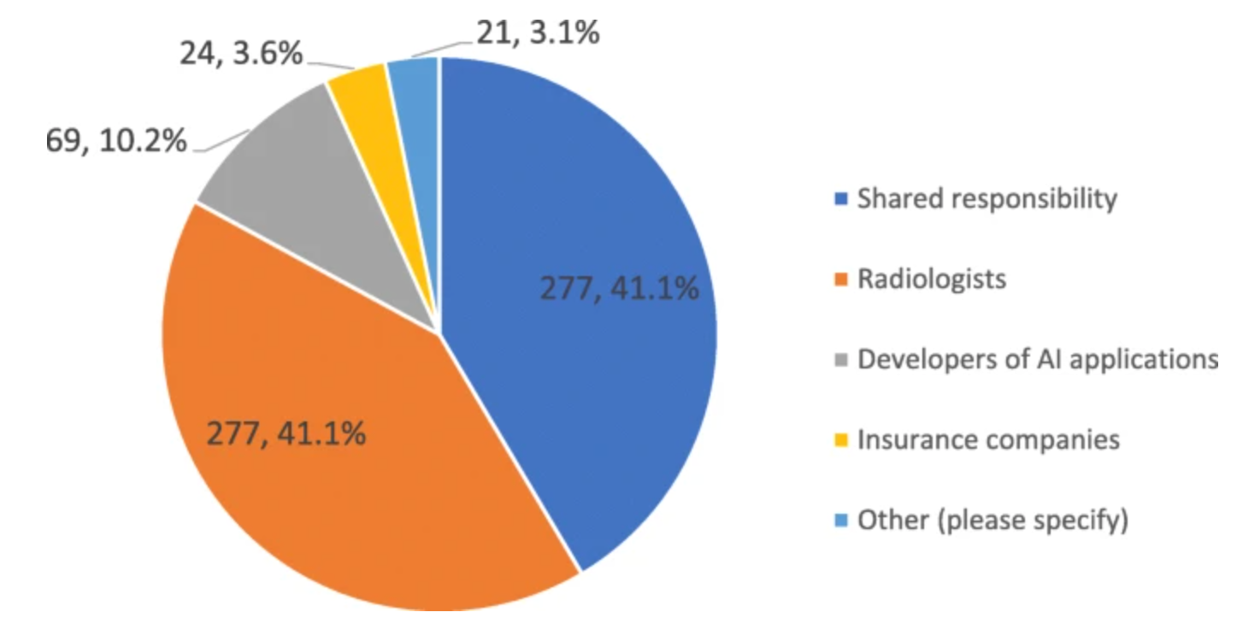
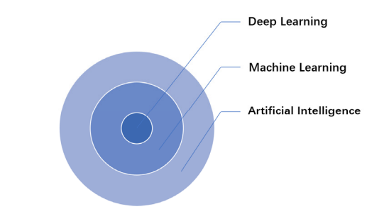
Literature Review
A survey involving 24,000 members of the European Society of Radiology (ESR) in 2018 asked them about their expectations regarding artificial intelligence (AI) in the next five to ten years.
Computer scientists developed deep learning that contributed to improve the image quality of diagnostic computed tomography (CT), and magnetic resonance imaging (MRI).
Deep learning (DL) and machine learning (ML) are under the umbrella of artificial intelligent.

Slide 9
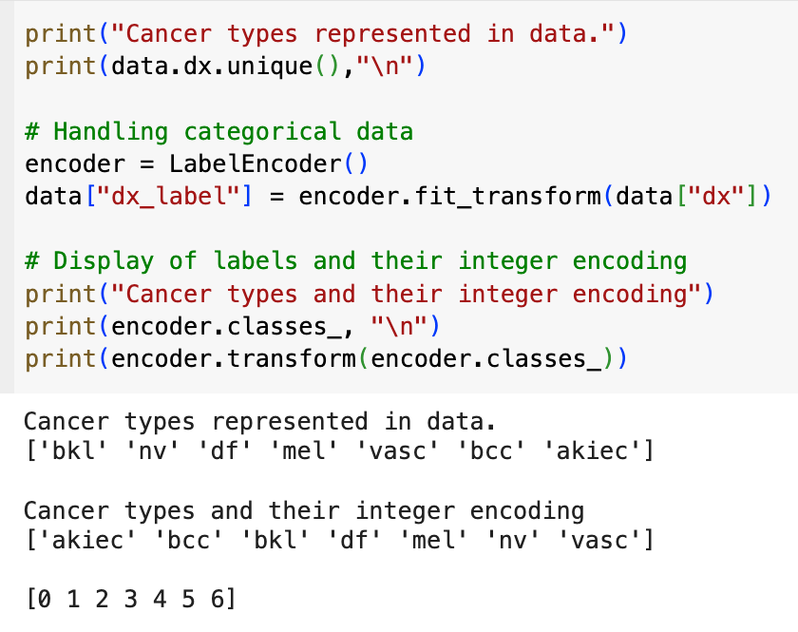
Approach
A dataset of more than 10000 images of darmtoscopic collected for a training set.
Histopathology which comprises of the diagnosis and study of diseases of the tissues used for most of pigmented lesion confirmation.
Seven different features selected and used for diagnosis and prediction types of skin cancer.
In this project I selected HAM10000 (“Human Against Machine with 10000 Training Images”) to resolve issue of dataset size and increased the number of features.
CNN is used to take images as inputs, extracts, and learns the features of image and classifies them accurately.

Slide 10
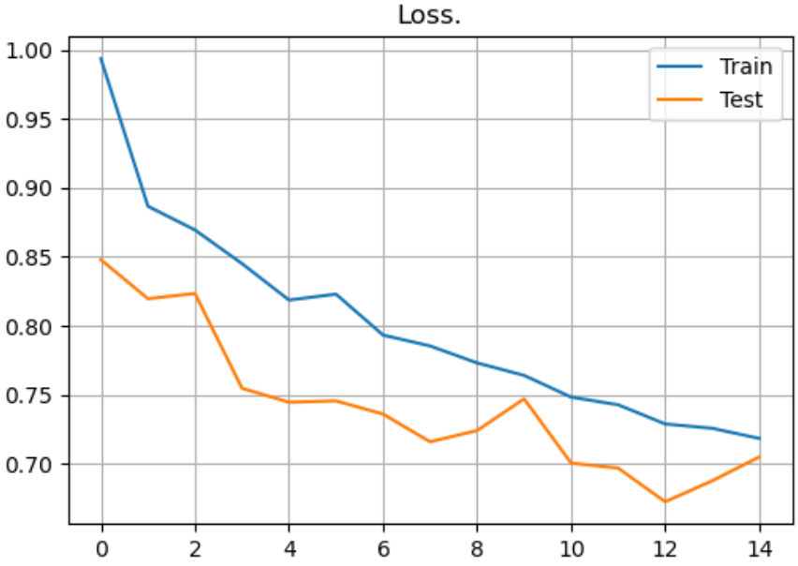
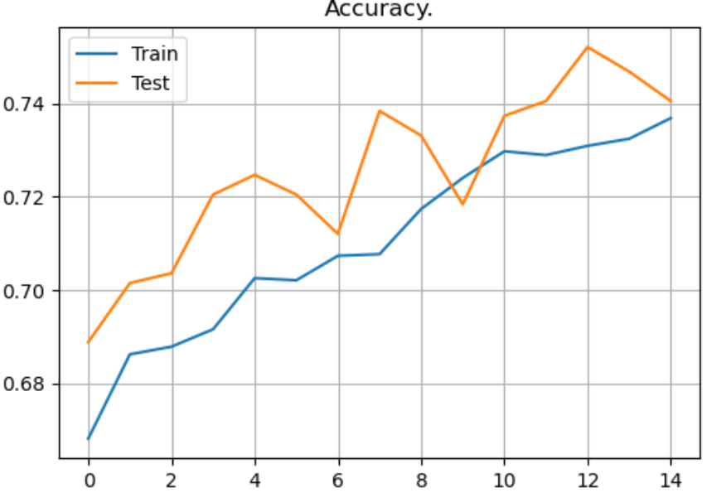
Data Collection
Data comes from Kaggle.
A large dataset collected from the HAM10000.
Images of dermatoscopic collected from different populations.
About 10015 dermatoscopic images used to train machine learning.
The visualizing metrics used for training and testing of loss and accuracy.

Slide 11
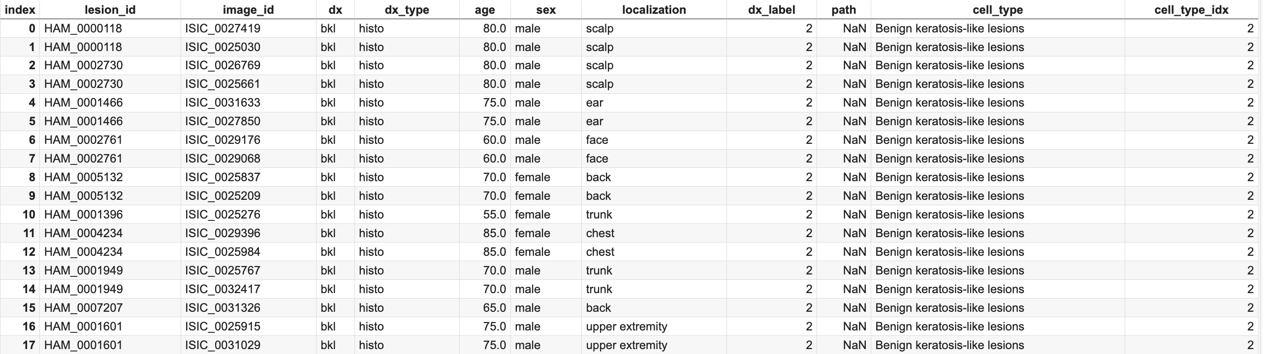
Data Analysis
Data collected and categorized into different columns.
Data information from HAM10000 dataset of Kaggle.
Data cleaning was performed to achieve consistency.
More male victims of skin cancer than females.
The localization area seems back, lower extremity.

Slide 12
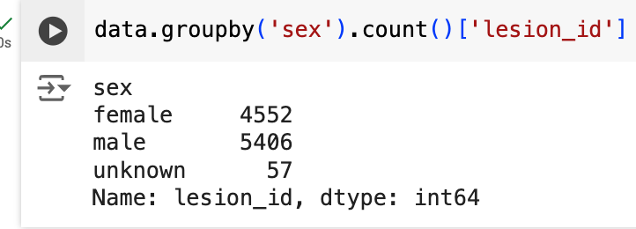
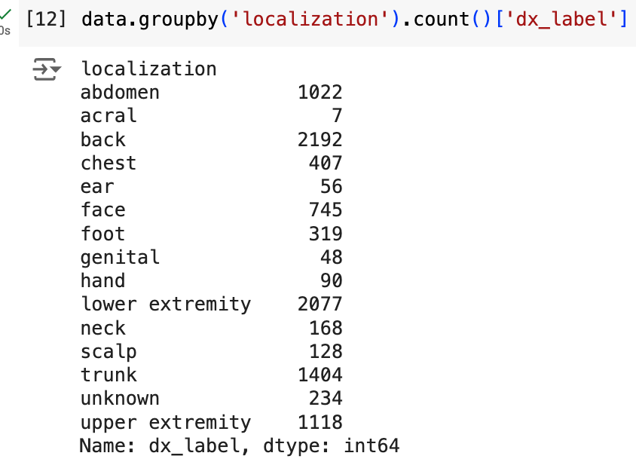
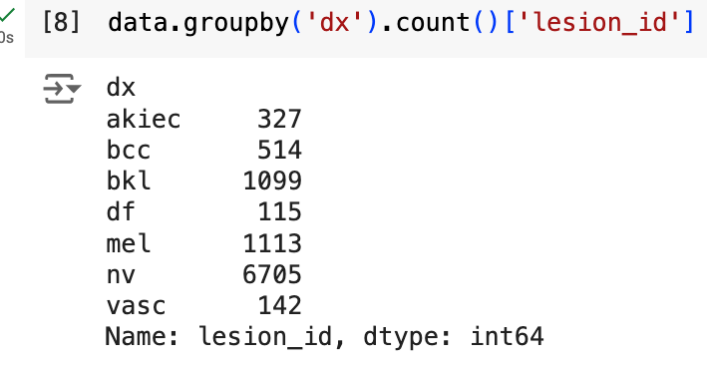
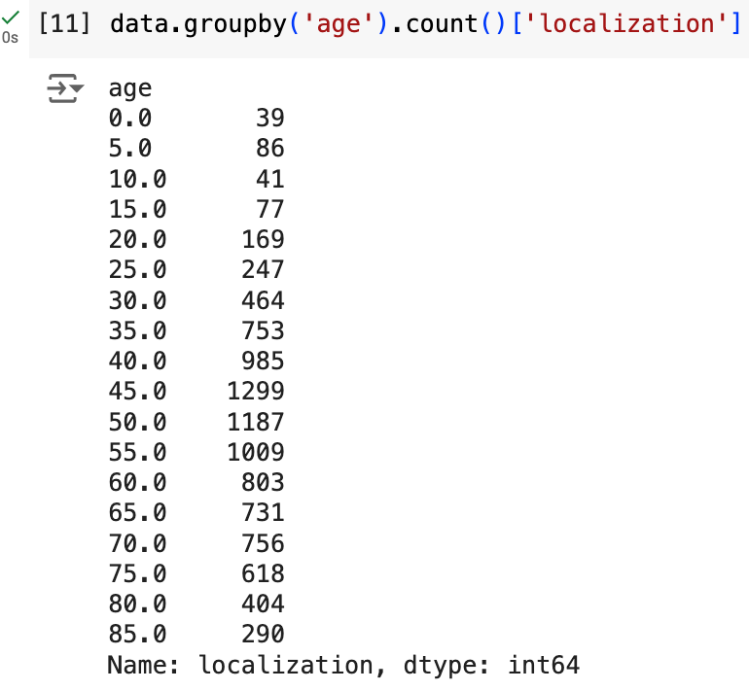
Finding
More male affected than female
The more affected areas of skin cancer symptoms back (2192), lower extremity (2077), trunk (1404), upper extremity (1118), abdomen (1022), etc
More male in 40’s and 50’s were victims of skin cancer symptoms.
More melanocytic nevi (6705) than melanoma (1113) skin cancer types.

Slide 13
Conclusion
analyzing large datasets of medical records and patient information.
The kinds of skin cancer and their different features are analyzed using artificial intelligence very quickly and with high accuracy.
AI algorithms can process a large amount of data and identify patterns that may not be easily detected by human doctors.
It is the ultimate goal of this study to observe how artificial intelligence improves patient outcomes by detecting skin cancers from large datasets of images and allowing providers to make decisions based on their results.

Slide 14
Future Work
Researchers should continue exploring the use of artificial intelligence to train large datasets of health issues such as heart attacks to detect early and give timely treatment in the future.
Diversifying the features of AI is essential for a better training experience.
Integrating genetic and wearable device data could contribute to AI training by providing additional insights.

Slide 15
Key References
Codari, M., Melazzini, L., Morozov, S. P., van Kuijk, C. C., Sconfienza, L. M., Sardanelli, F., & European Society of Radiology (ESR). (2019). Impact of artificial intelligence on radiology: A EuroAIM survey among members of the European Society of Radiology. Insights into Imaging, 10(1), 105. https://doi.org/10.1186/s13244-019-0798-3
Esteva, A., Kuprel, B., Novoa, R. A., Ko, J., Swetter, S. M., Blau, H. M., & Thrun, S. (2017). Dermatologist–level classification of skin cancer with deep neural networks. Nature, 542(7639), 115–118. https://doi.org/10.1038/nature21056
Gorelik, N., & Gyftopoulos, S. (2021). Applications of artificial intelligence in musculoskeletal imaging: From the request to the report. Canadian Association of Radiologists Journal = Journal l’Association Canadienne Des Radiologistes, 72(1), 45–59. https://doi.org/10.1177/0846537120947148
Harmon, S. A., Tuncer, S., Sanford, T., Choyke, P. L., & Türkbey, B. (2019). Artificial intelligence at the intersection of pathology and radiology in prostate cancer. Diagnostic and Interventional Radiology, 25(3), 183–188. https://doi.org/10.5152/dir.2019.19125

Slide 16
Key References
Hosny, A., Parmar, C., Quackenbush, J., Schwartz, L. H., & Aerts, H. J. W. L. (2018). Artificial intelligence in radiology. Nature Reviews. Cancer, 18(8), 500–510. https://doi.org/10.1038/s41568-018-0016-5
Jin, D., Harrison, A. P., Zhang, L., Yan, K., Wang, Y., Cai, J., Miao, S., & Lu, L. (2021). Chapter 14—Artificial intelligence in radiology. In L. Xing, M. L. Giger, & J. K. Min (Eds.), Artificial Intelligence in Medicine (pp. 265–289). Academic Press. https://doi.org/10.1016/B978-0-12-821259-2.00014-4
Lepakshi, V. A. (2022). Machine learning and deep learning based ai tools for development of diagnostic tools. Computational Approaches for Novel Therapeutic and Diagnostic Designing to Mitigate SARS-CoV-2 Infection, 399–420. https://doi.org/10.1016/B978-0-323-91172-6.00011-X
Li, X., Tian, J., Nan, N., Tu, C., Zhang, D., Song, X., & Zhang, H. (2021). Artificial intelligence based myocardial ischemia detection in cardiac radiology. Proceedings of the 2nd International Symposium on Artificial Intelligence for Medicine Sciences, 109–113. New York, NY, USA: Association for Computing Machinery. https://doi.org/10.1145/3500931.3500951
Liu, Y., Jain, A., Eng, C., Way, D. H., Lee, K., Bui, P., … Coz, D. (2020). A deep learning system for differential diagnosis of skin diseases. Nature Medicine, 26(6), 900–908. https://doi.org/10.1038/s41591-020-0842-3

Slide 17
Key References
Mazurowski, M. A., Buda, M., Saha, A., & Bashir, M. R. (2019). Deep learning in radiology: An overview of the concepts and a survey of the state of the art with focus on MRI. Journal of Magnetic Resonance Imaging: JMRI, 49(4), 939–954. https://doi.org/10.1002/jmri.26534
Mei, X., Liu, Z., Robson, P. M., Marinelli, B., Huang, M., Doshi, A., Jacobi, A., Cao, C., Link, K. E., Yang, T., Wang, Y., Greenspan, H., Deyer, T., Fayad, Z. A., & Yang, Y. (2022). Radimagenet: An open radiologic deep learning research dataset for effective transfer learning. Radiology: Artificial Intelligence, 4(5), e210315. https://doi.org/10.1148/ryai.210315
Pianykh, O. S., Langs, G., Dewey, M., Enzmann, D. R., Herold, C. J., Schoenberg, S. O., & Brink, J. A. (2020). Continuous learning ai in radiology: Implementation principles and early applications. Radiology, 297(1), 6–14. https://doi.org/10.1148/radiol.2020200038
Plis, S. M., Hjelm, D. R., Salakhutdinov, R., Allen, E. A., Bockholt, H. J., Long, J. D., … Calhoun, V. D. (2014). Deep learning for neuroimaging: A validation study. Frontiers in Neuroscience, 8. https://doi.org/10.3389/fnins.2014.00229
Syed, A. B., & Zoga, A. C. (2018). Artificial intelligence in radiology: Current technology and future directions. Seminars in Musculoskeletal Radiology, 22(5), 540–545. https://doi.org/10.1055/s-0038-1673383
Tschandl, P., Rosendahl, C., & Kittler, H. (2018). The HAM10000 dataset, a large collection of multi-source dermatoscopic images of common pigmented skin lesions. Scientific Data, 5(1), 180161. https://doi.org/10.1038/sdata.2018.161

Slide 18


Q&A

